Slide 1
MENTAL HEALTH
Author: Neža Urbas
School year: 2015/2016

Slide 2
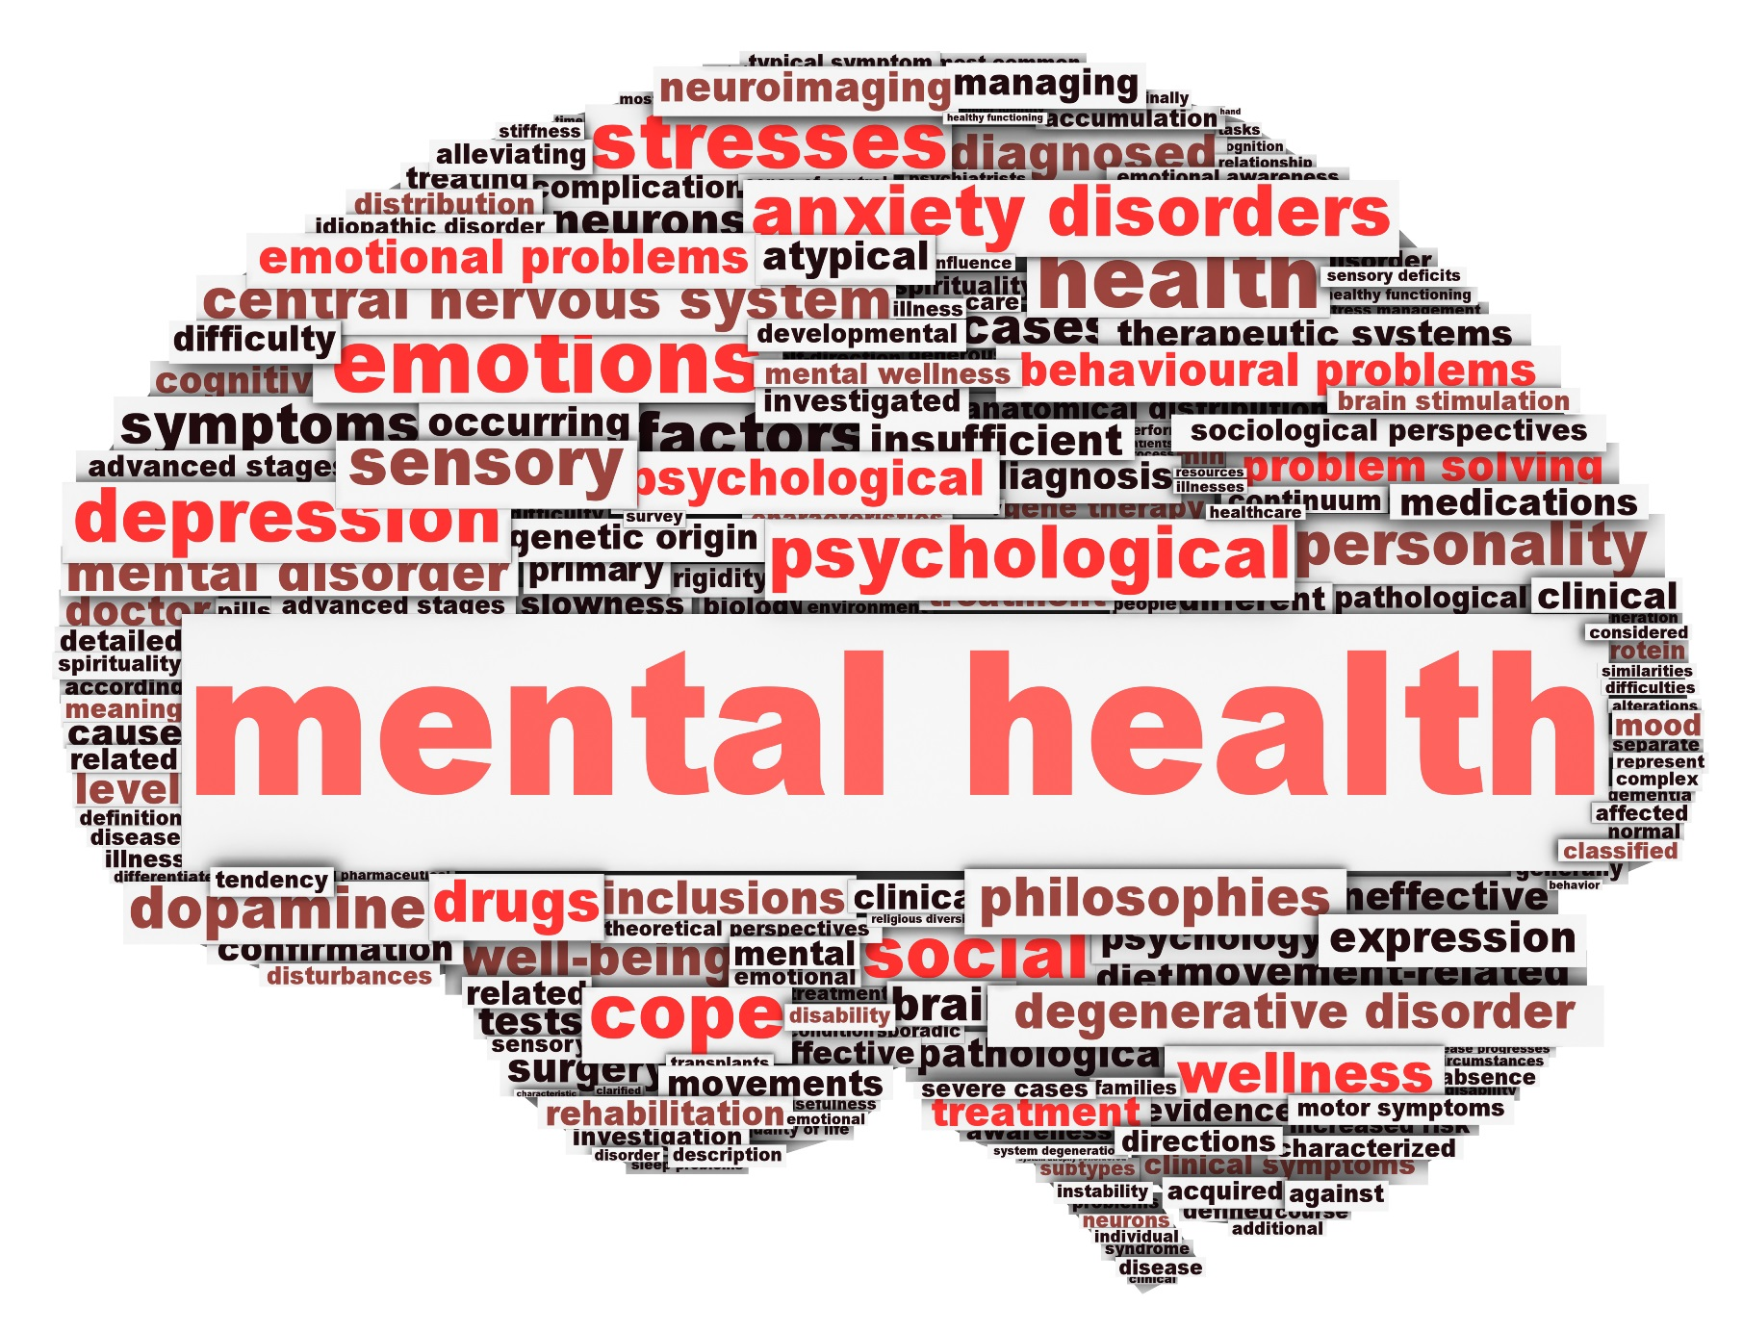
Mental health
Level of psychological well-being
Holism perspective: ability to enjoy life, psychological resilience
WHO: subjective well-being, self-efficiacy, competence, self-actualization,
Coping with normal stress, realization of abilities,
contribution to community
Concerns: stress, depression, anxiety, addiction,
ADHD, …

Slide 3
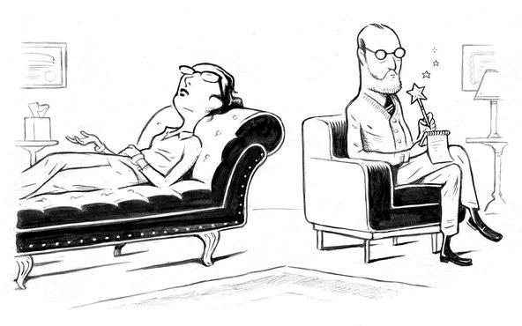
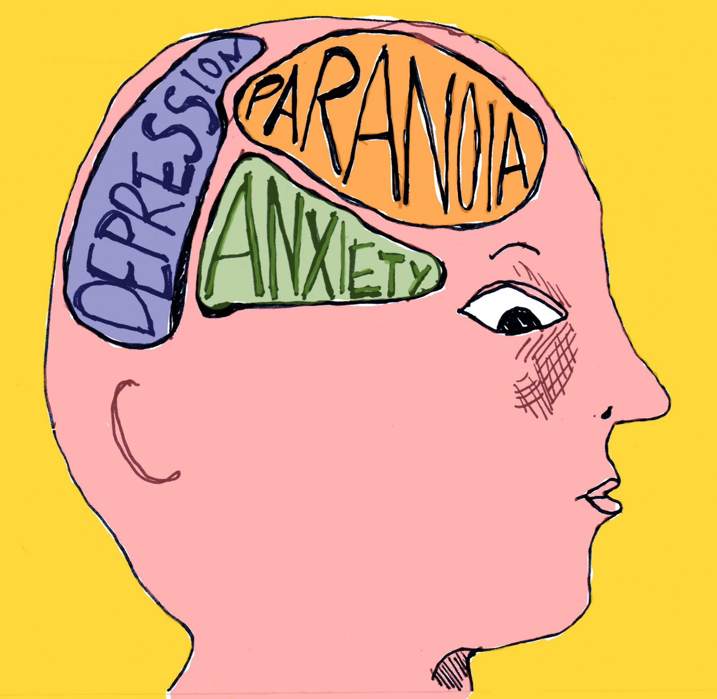

Slide 4
Mental disorders
Mental health conditions, that affect your mood, thinking, behavior.
1 in 5 adults
Anxiety, mood disorders, personality disorders, psychotic disorders
Shizophrenia,
Genetics, exposure to environmental factors before birth, changes in brain.
Everyday stress, ongoing medical condition, traumatic experiences, alcohol or recreational drugs, abused, neglected children.

Slide 5
Depression
Medical illness
A combination of genetic, biological, environmental, and psychological factors.
Bipolar disorder, seasonal affective depression, postpartum depression, psychotic depression
Antidepressants, Psychotherapy (by restructuring negative thought patterns or understanding and working through troubled situations and relationships.
6.7% of U.S adults, women 70 % more likely, 3.3% of 13 to 18 year olds

Slide 6
Symptoms
Persistent sad, anxious, or "empty" feelings
Feelings of hopelessness or pessimism
Feelings of guilt, worthlessness, or helplessness
Irritability, restlessness
Loss of interest in activities or hobbies once pleasurable, including sex
Fatigue and decreased energy
Difficulty concentrating, remembering details, and making decisions
Insomnia, early-morning wakefulness, or excessive sleeping
Overeating, or appetite loss
Thoughts of suicide, suicide attempts
Aches or pains, headaches, cramps, or digestive problems that do not ease even with treatment.

Slide 8
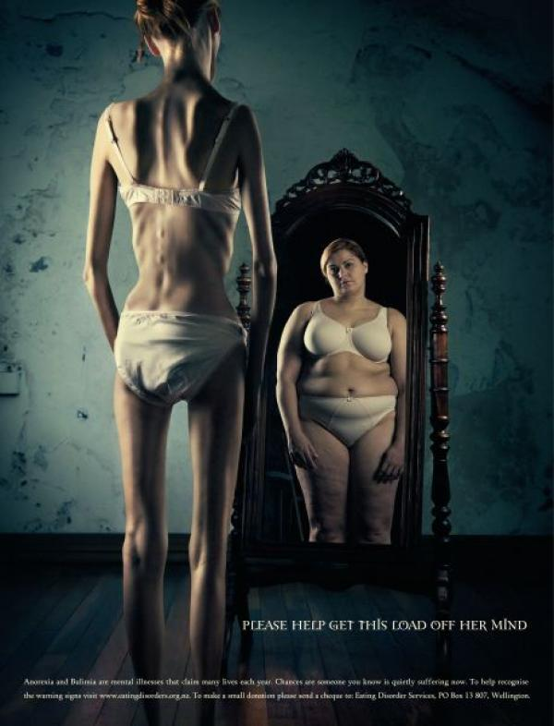
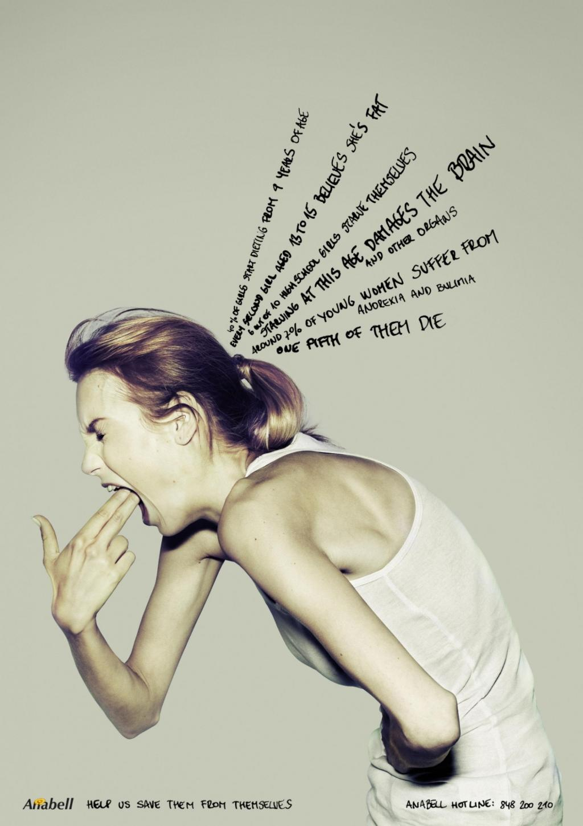
Eating disorders
Mental disorder
Anorexia nervosa, bulimia nervosa, binge eating disorder, orthorexia nervosa, diabulimia, drunkorexia, compulsive overeating
How person sees himself – body dismorphic disorder
Websites encouraging people to maintain eating disorders

Slide 9
Revision
Mental health in general?
How does the WHO define mental health?
List some mental disorders
Why do they occur?
What is depression?
List some types of depression.
Explain eating disorders (Why? Who? What types?)

Slide 10
New words
Autonomy
Self-efficacy
Resilience

Slide 11
References
https://en.wikipedia.org/wiki/Mental_health
http://www.news.cornell.edu/stories/2011/02/mental-health-approach-supports-whole-person
http://laurazera.com/wp-content/uploads/2013/09/Mental-Health.jpg
http://brainpictures.org/large/89/Depression-Brain-Pictures-1.jpg
https://www.nimh.nih.gov/health/topics/depression/index.shtml
http://www.sherrehirsch.com/wp-content/uploads/mental-health_1.jpg
http://media.salemwebnetwork.com/cms/CW/11878-mental_illness_help%20630x315.jpg
http://blogs.psychcentral.com/my-meds/files/2012/01/Serious-mental-illness.jpg
http://graphics8.nytimes.com/images/2013/03/26/science/26CONS_SPAN/26CONS-tmagArticle.jpg
http://files1.coloribus.com/files/adsarchive/part_588/5885055/file/eating-disorder-services-mirror-small-48856.jpg
https://en.wikipedia.org/wiki/Eating_disorder
http://www.psych2go.net/wp-content/uploads/2015/06/eating-disorders-awareness-help-us-save-them-1024-93641.jpg

