Slide 1

MY WORKOUT
Erasmus + Hana Petrač, 1.d

Slide 2
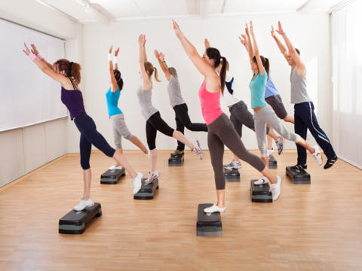
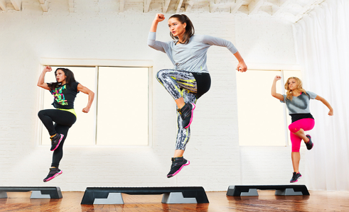
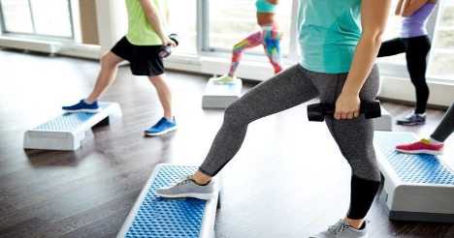
Step aerobics
Step up and down
Correct posture
Head up
Shoulders back

Slide 3

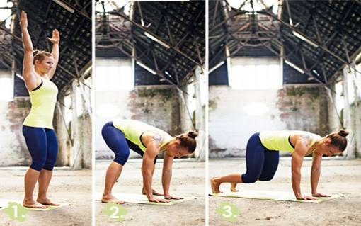
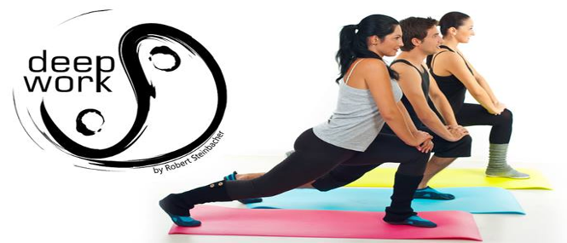
Deep work
Mental and physical opposites
Connection between tension and relaxation
Five elements

Slide 4

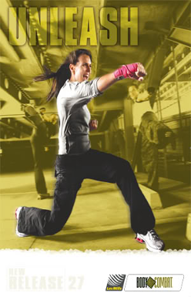
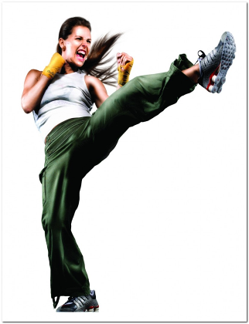

Body combat
inspired by martial arts and draws from wide array
Stike, punch, kick

Slide 5

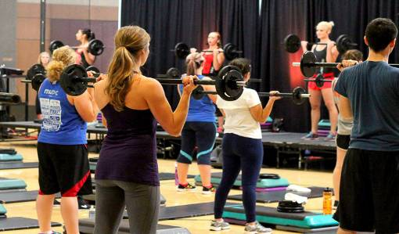
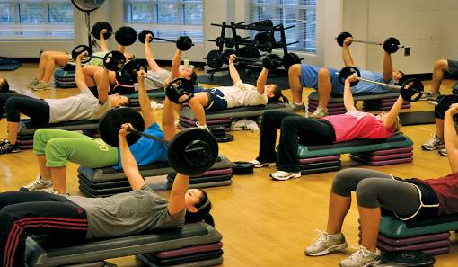
Body pump
Major muscle groups
Squats, presses, lifts, curls
Low weight loads
Stength and endurance
70-100 repetitions per body part

Slide 6
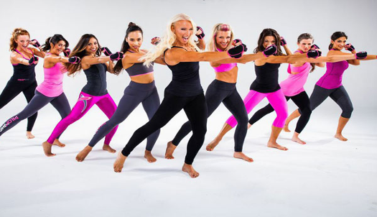
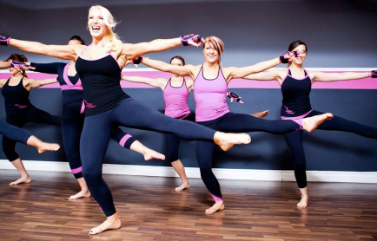
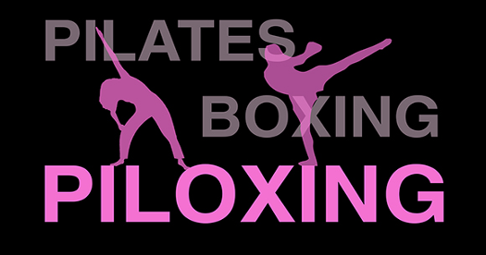
PILOXING
High-spirited interval workout
Hiphop, salsa, ballet moves
Piloxing targets thighs, arms, abdominals, rear

Slide 7
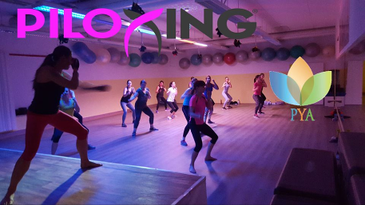
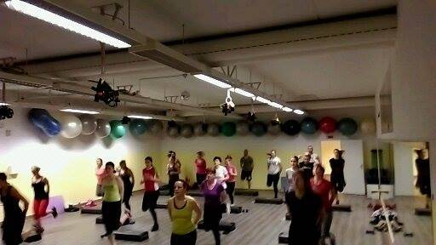
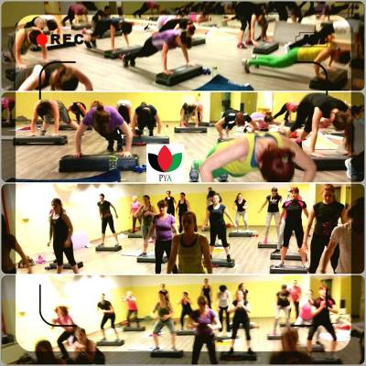
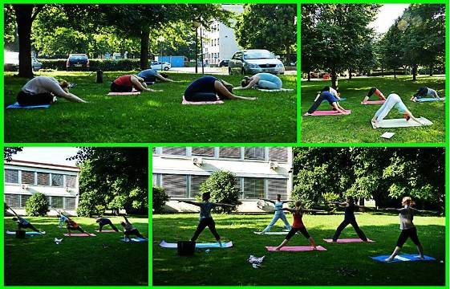
https://www.youtube.com/watch?v=nO_2wc00H5U

Slide 8
Sources and literature
http://a4.mzstatic.com/us/r30/Purple/v4/f7/90/4b/f7904b32-2739-9e81-cb4b-34dd4b0c92f6/screen480x480.jpeg
http://www.thestep.com/core/media/media.nl?id=68&c=312036&h=9a5ad48a3f593dab83b7&resizeid=-2&resizeh=500&resizew=500
http://www.cusnapoli.it/cusnapoli/wp-content/uploads/2014/03/fitnesscorpolibero-step.jpg
http://img.aws.livestrongcdn.com/ls-article-image-640/cme/cme_public_images/www_livestrong_com/photos.demandstudios.com/getty/article/108/137/487436408_XS.jpg
http://img1.brigitte.de/asset/Image/figur/fitness/deep-work/jump-front.jpg?cache=1132141659
http://www.retrosport.sk/wp-content/uploads/image001.jpg
http://www.campo-sports.de/kursplan/deep-work/93.html
http://flexgroupfitness.net/ImageStore/ClientSite/7165/Resources/CustomPages/bodycombat_2.png
http://recsports.oregonstate.edu/files/fitness/photos/web_resized-3.jpg
http://media.piloxing.com.s3.amazonaws.com/instructor-training/piloxing-600x400.jpg
http://follow-your-dream.ch/images/Piloxing-pilates.jpg
http://www.thevalentinerd.com/wp-content/uploads/2014/01/Piloxing-Gloves.jpg
http://www.yukbook.me/YukBook/images/articles/Piloxing.jpg

